Slide 1

CIS 501 Final Project Presentation
Team 10 – Client
Paula Mendez
Luis Bobadilla
Nick Goins
Team 8 – Server
Matt Weis
Jonathan Howard
James Minton

Slide 2
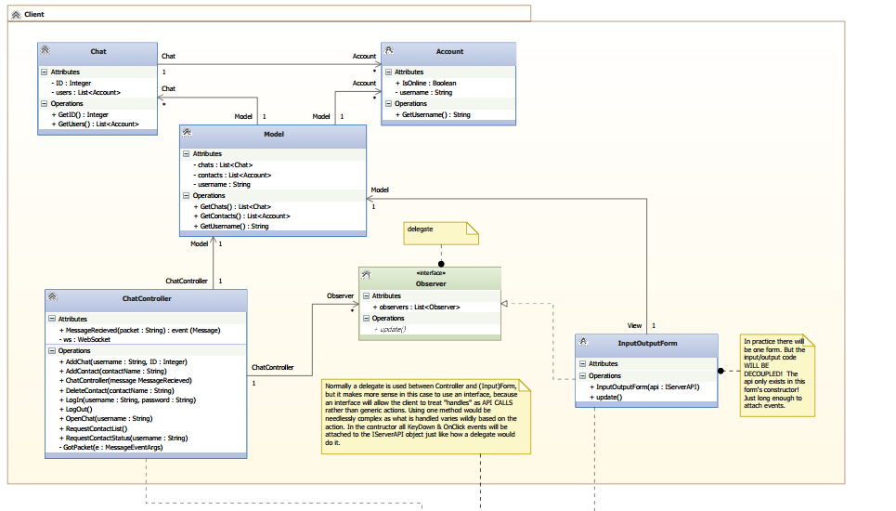
Original design - Client

Slide 3
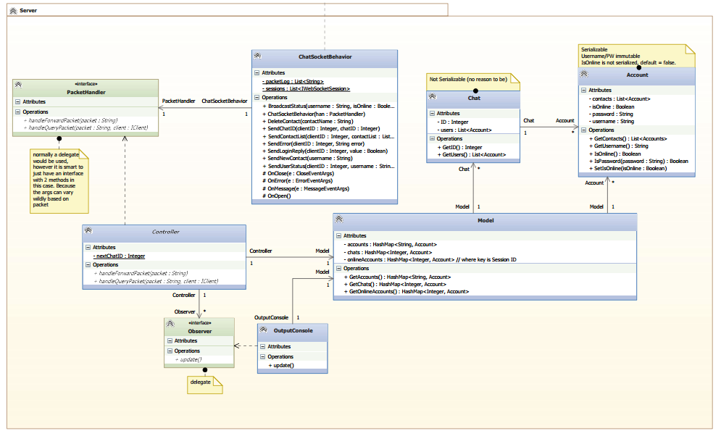
Original design - Server

Slide 4
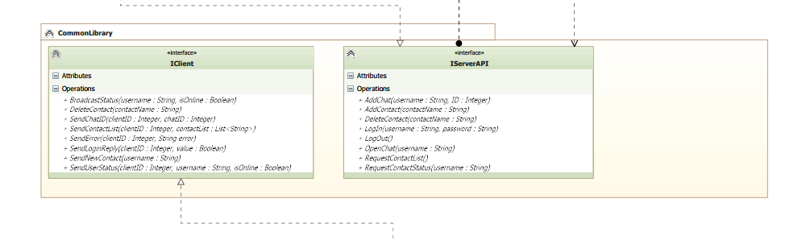
Original design – Class Library

Slide 5
Why did we choose this design?

Slide 6
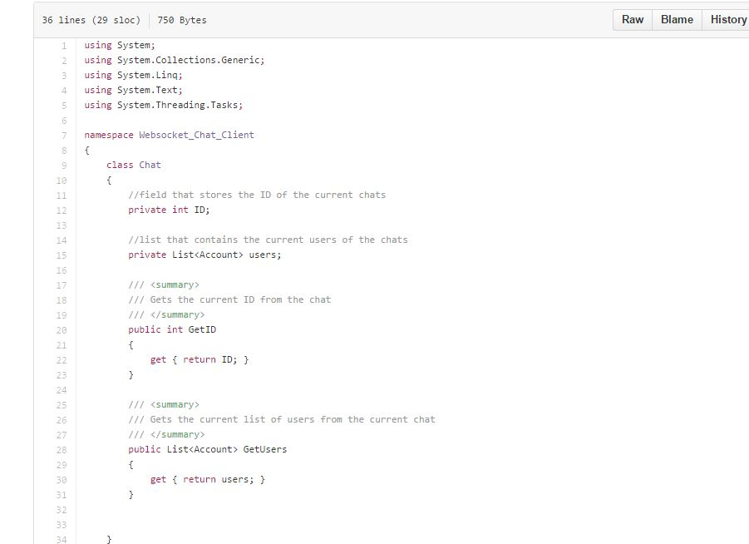

Slide 7
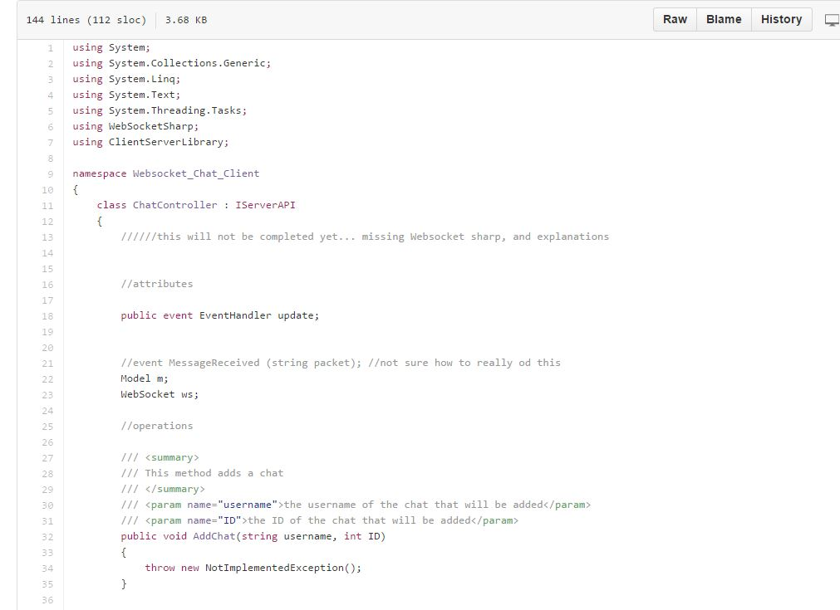

Slide 8
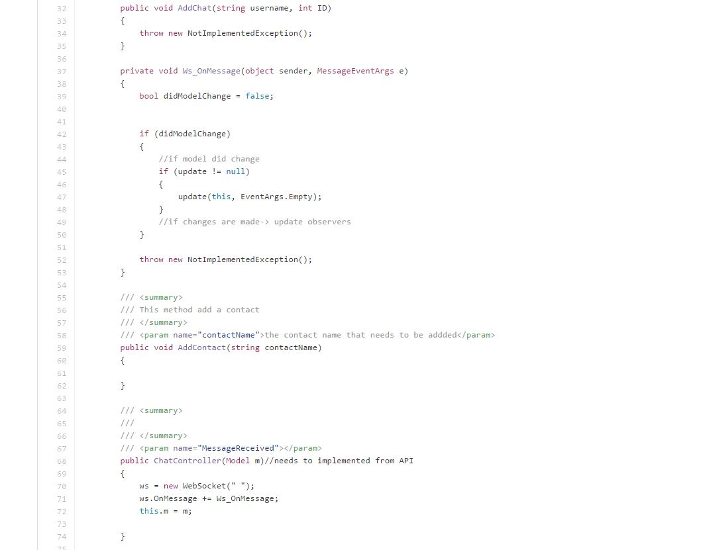

Slide 9
DEMO

Slide 10
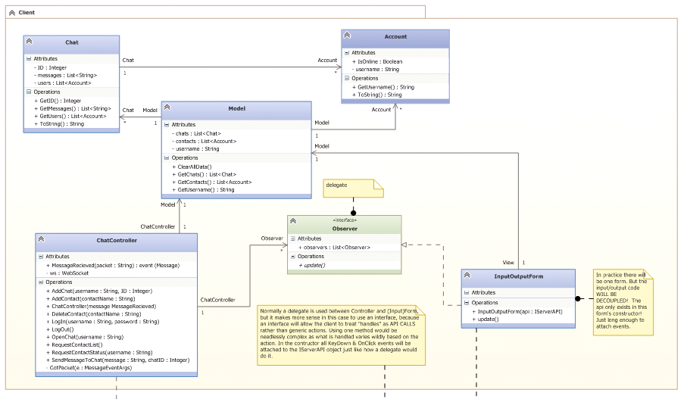
Updated design – Client Updated

Slide 11
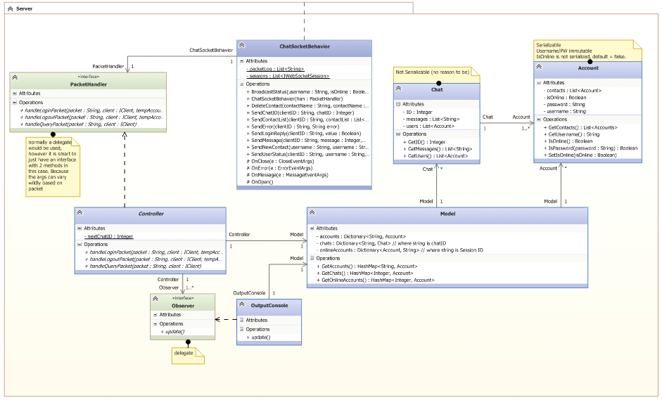
Updated design – Server Updated

Slide 12
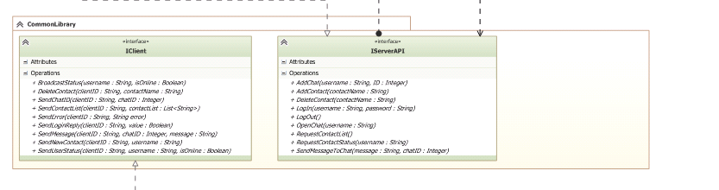
Updated design – Class Library Updated

Slide 13
Why did we make these changes?

Slide 14
Lessons learned during this project
  Lambda expressions
  Observer design pattern
  Details of working in a large scale team project.

Slide 15
Lessons learned during this project that will be applied in the future
How to use
  JSON Serialization
  Web socket API (Send/Receive Packets)
How to properly implement MVC in visual studio
Delegate for handling events

Slide 16
Thanks!

